Slide 1
Practice Questions

Slide 2
Problem 1
Bob's public RSA key is (N , e)=(35, 19). His private key is d=19. For signing, Bob uses the hash function H(x) = x (mod 22). Determine Bob's signature s of the message m = 361.

Slide 3
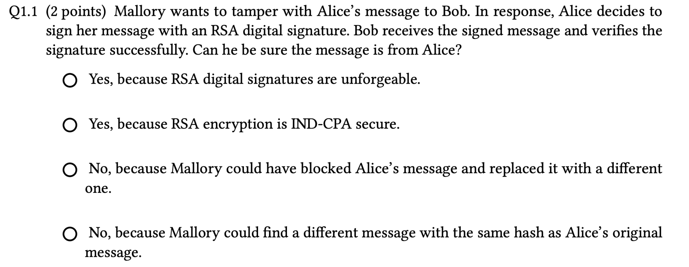
Problem 2

Slide 4
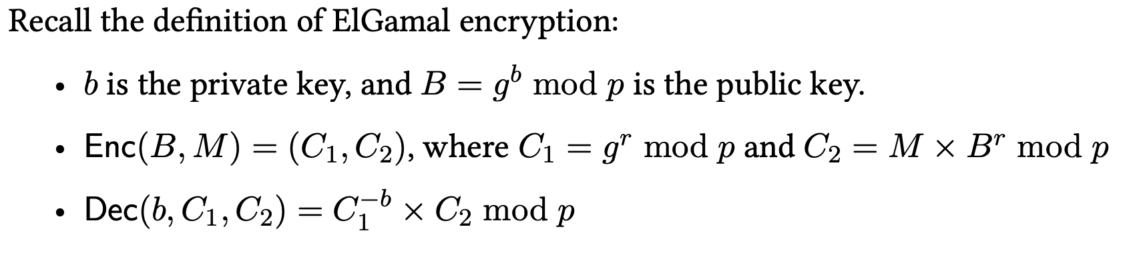
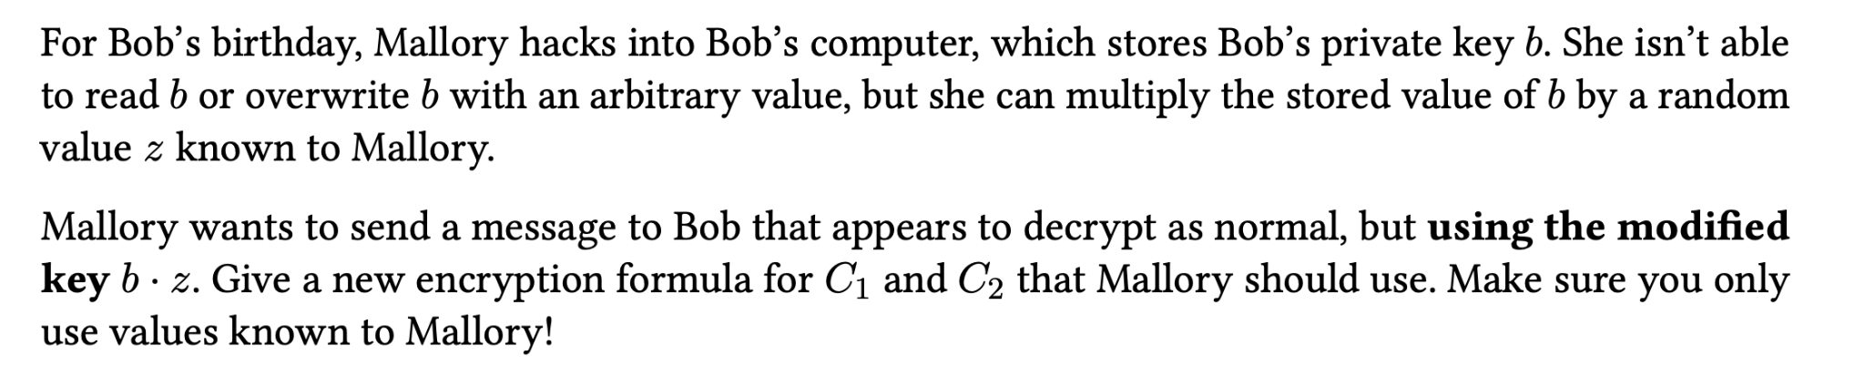
Assume B is unchanged throughout the process

Slide 5
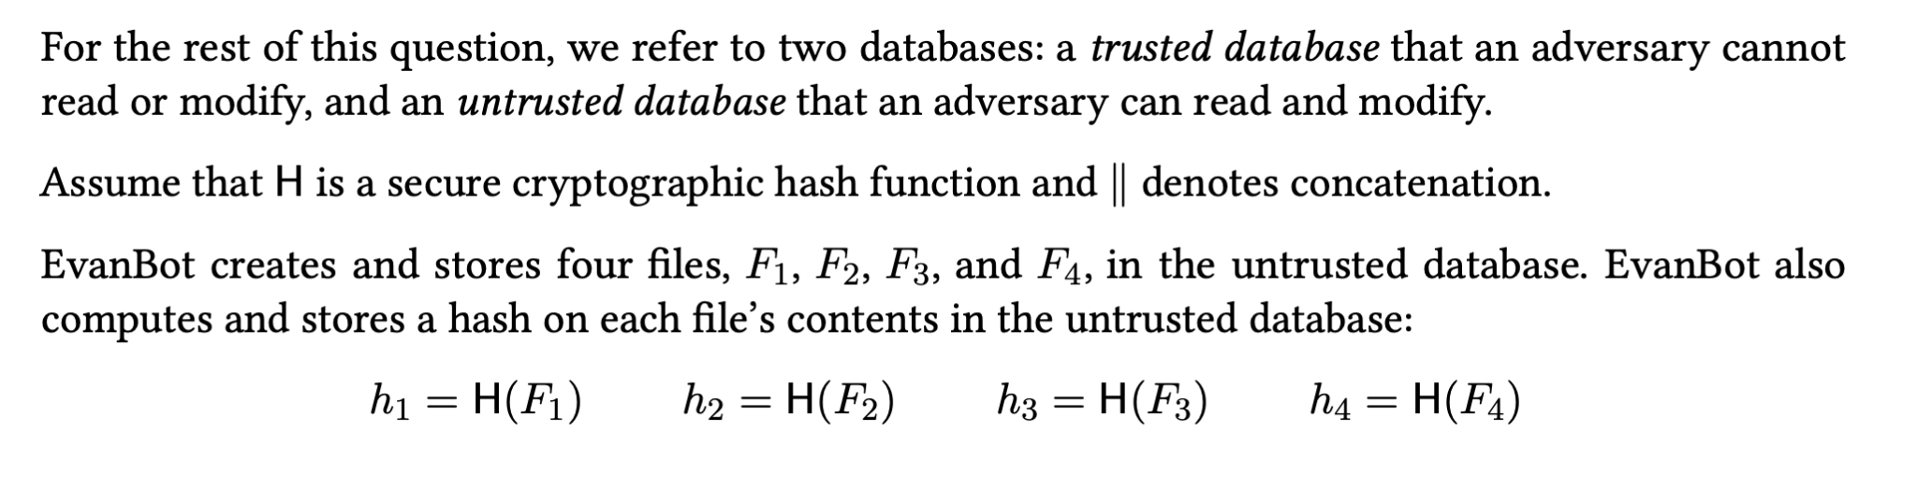
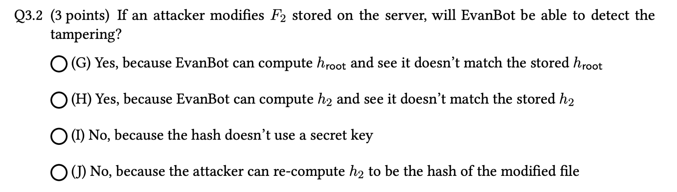
Problem 3

Slide 6
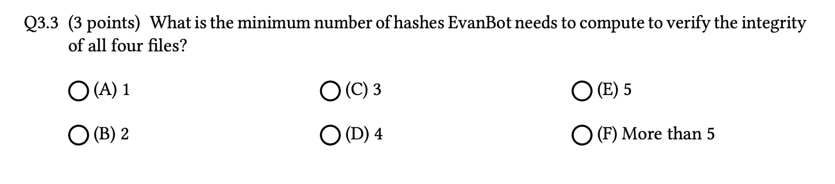
Problem 3

Slide 7
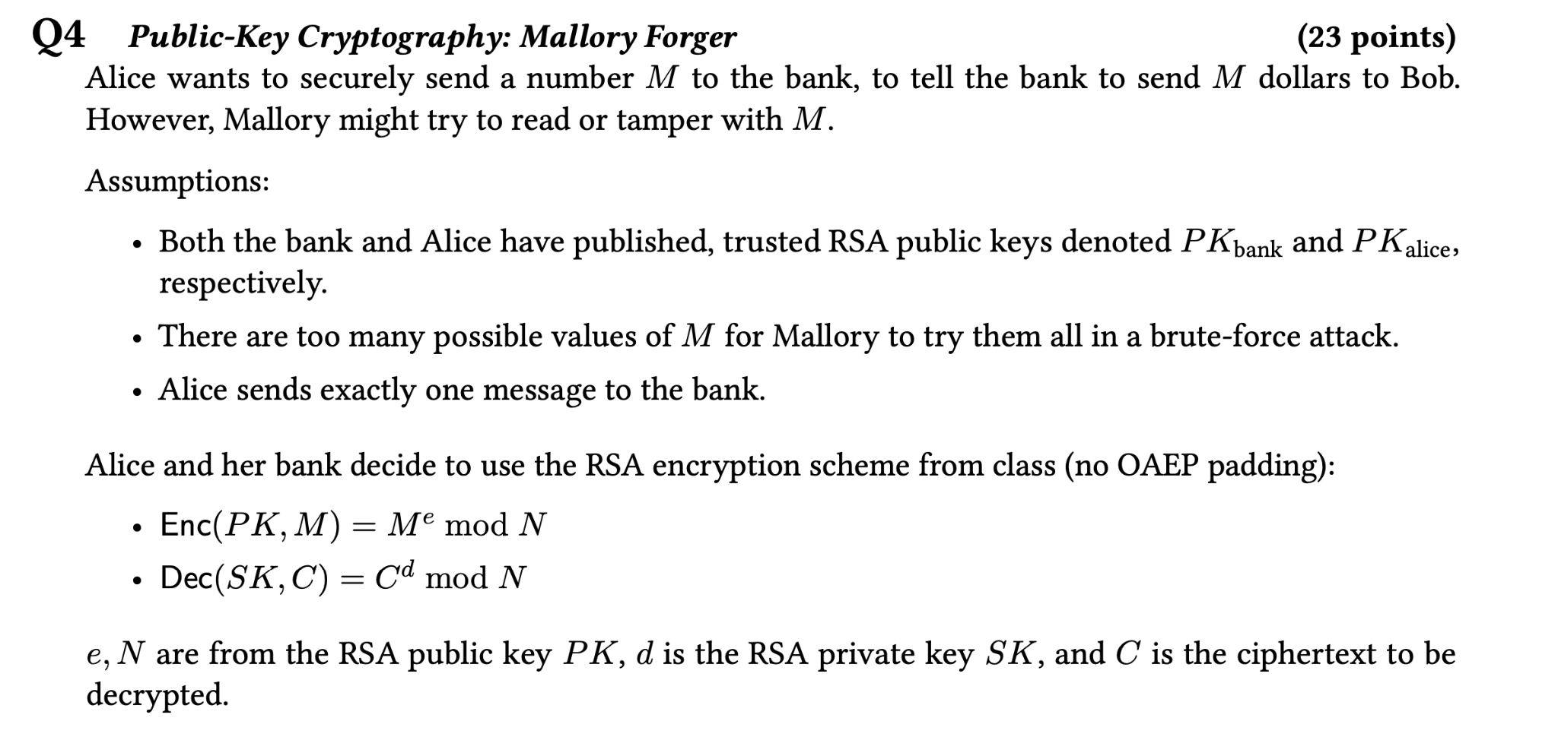
Problem 4

Slide 8
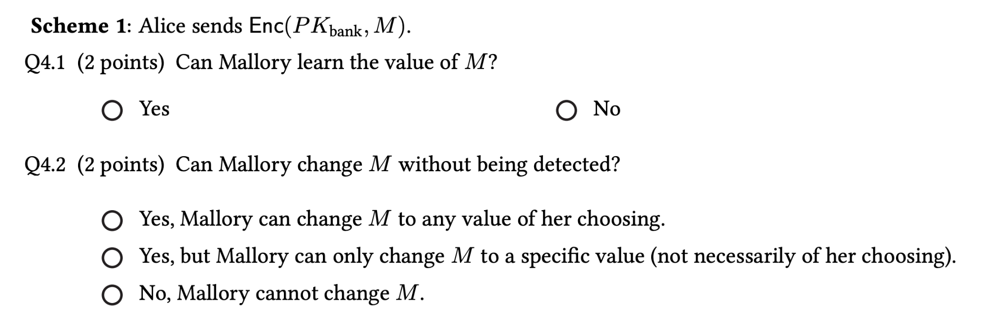
Problem 4
Mallory can intercept alice’s message, compute Enc(PK_{bank}, M`) and send that instead

Slide 9
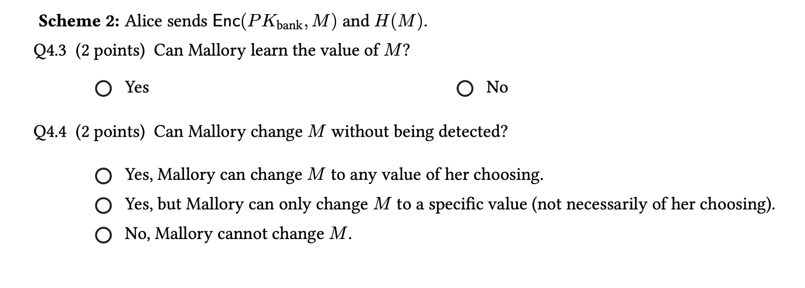
Problem 4
Same reasoning as before. Mallory can change H(M) as well.

Slide 10
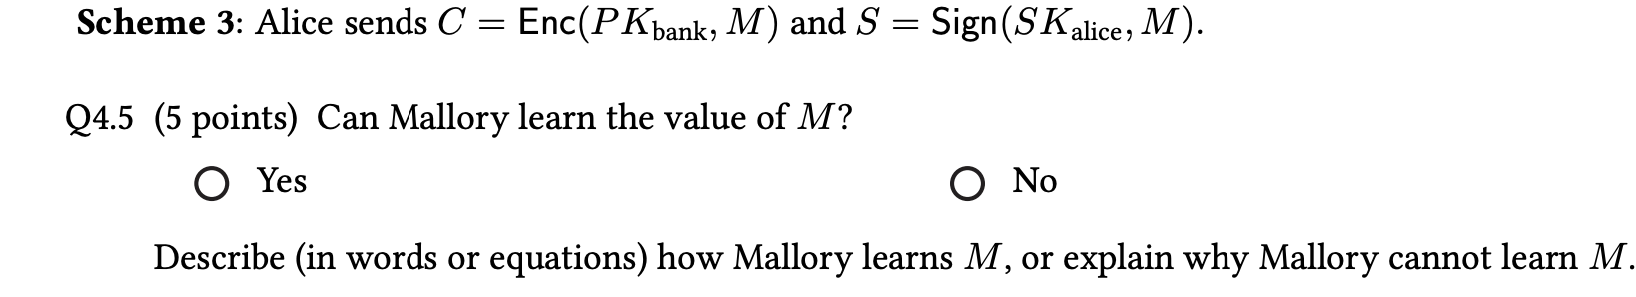
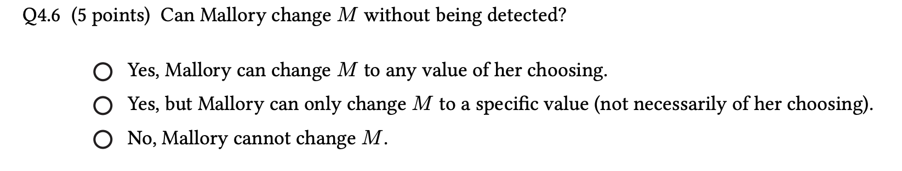
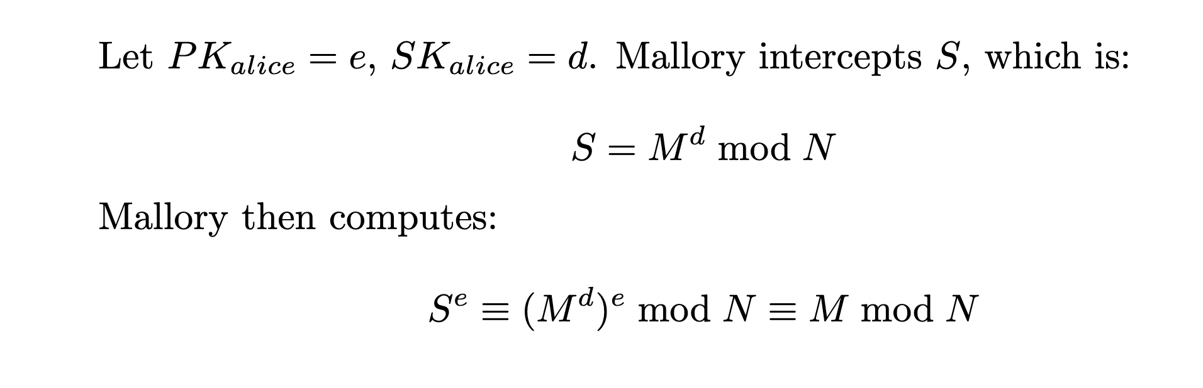
Problem 4
Mallory knows “e” since it is public.

Slide 11
Problem 4

Slide 12
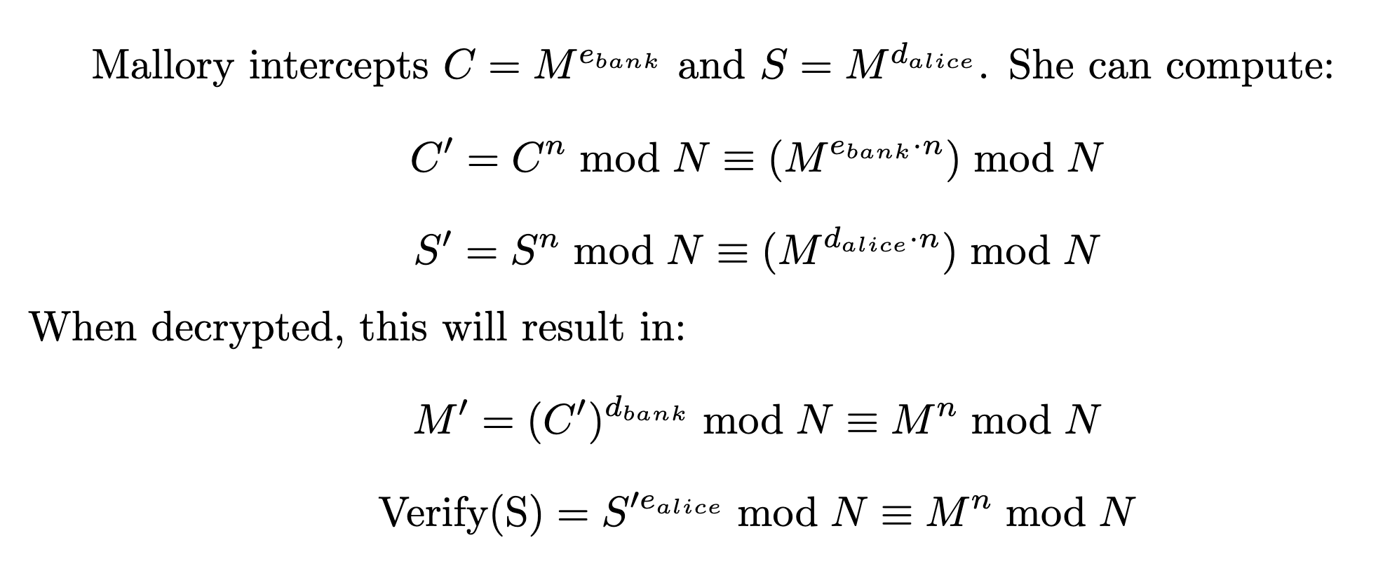
Problem 4

Slide 13
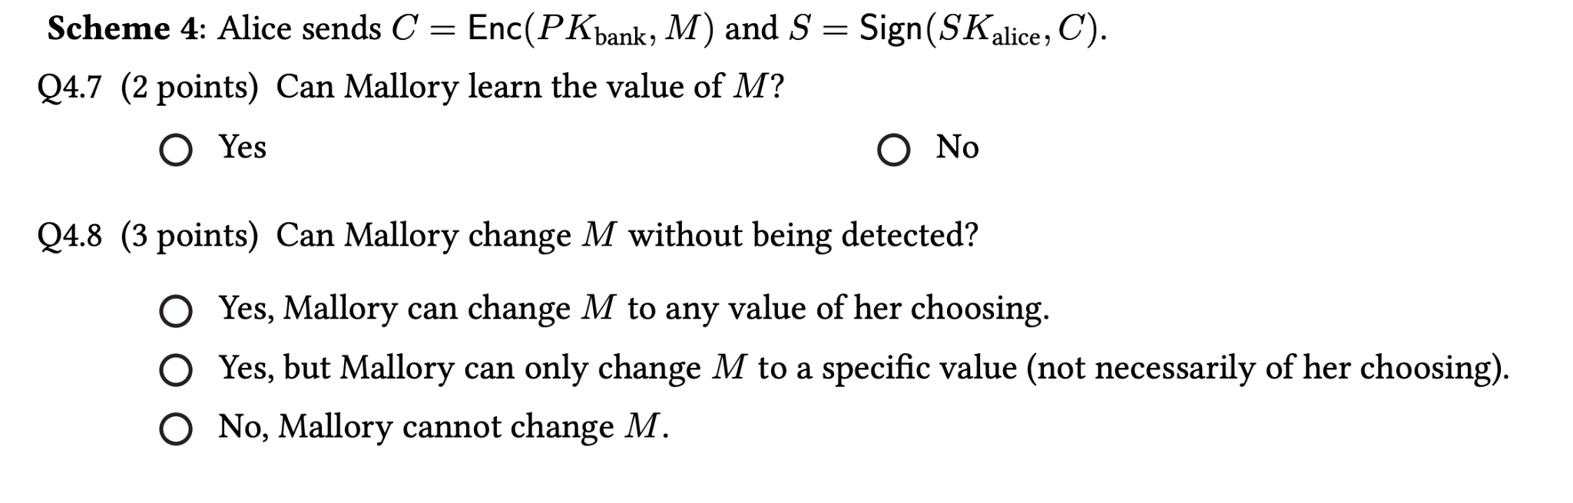
Problem 4

Slide 14
Problem 5
Ephemeral exchanges:
https://assets.cs161.org/exams/sp24/sp24mt.pdf#page=17

Slide 15
More questions at: https://textbook.cs161.org/

